Slide 1
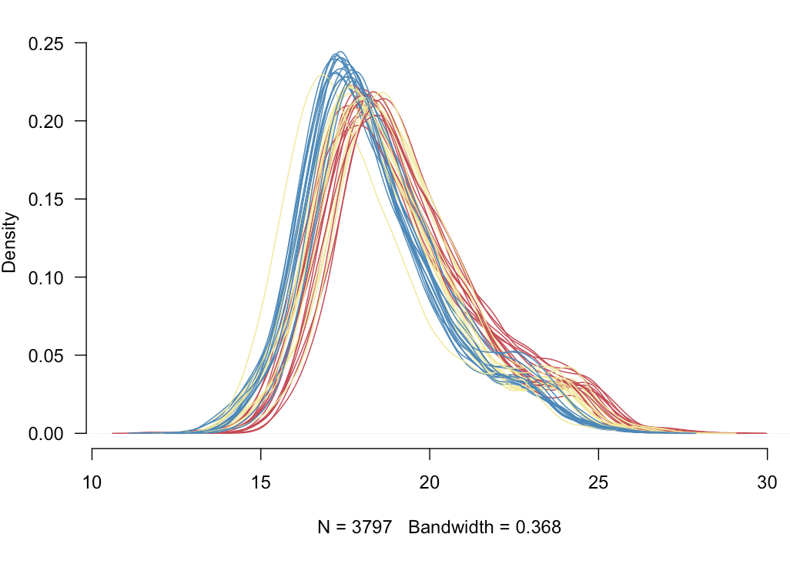
Peptide-level Robust Ridge Regression Improves Estimation, Sensitivity, and Specificity in Data-
dependent Quantitative Label-free Shotgun Proteomics. Mol. Cell Proteomics. 2016 15(2):657-68.

